Slide 1
随手做环保 Intermediate-Low

Slide 2
你记得吗？
http://hkcof.org/wp/wp-content/uploads/2014/11/greenpeace-004.jpg
http://a3.att.hudong.com/75/17/01300000327751122993171487921.jpg

Slide 3
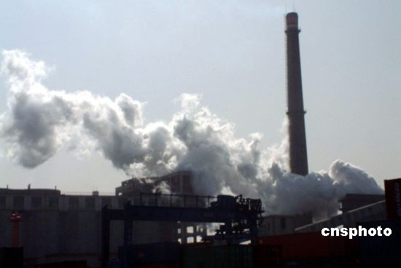
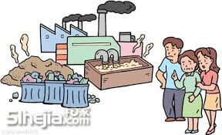
你记得吗？
为什么要环保？
怎么做环保？
http://photocdn.sohu.com/20060907/Img245216475.jpg
https://encrypted-tbn3.gstatic.com/images?q=tbn:ANd9GcTUeQCqlJVPeUxMMi6ZvGzCpIfAqvQi1FPwNKGa8E079zzdxleK

Slide 4
第一次分组

Slide 5
1.请找重点
http://3.bp.blogspot.com/-Bg92ZdcnRDY/VHaRFdd9kdI/AAAAAAAAAv8/Z3E-IF2WoyA/s1600/Slide02.jpg

Slide 6
3. 重新编组
https://raw.github.com/lukezhg/Freyja/master/jigsaw.png

Slide 7
4. 排顺序
Main Idea
Supporting Detail
Supporting Detail
Supporting Detail
Summary / Conclusion

Slide 8
4. 排顺序
Main Idea
Supporting Detail
Supporting Detail
Supporting Detail
Summary / Conclusion

Slide 9
把每段的重点综合起来称为文章摘要。
Main Idea
首先
Supporting Detail
而且
Supporting Detail
最后
Supporting Detail
Summary / Conclusion

